Slide 1
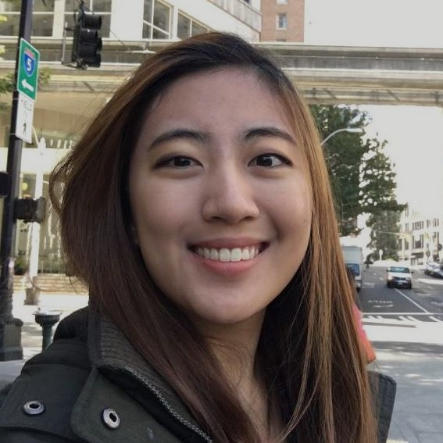



Na He Jeon
Junwon Park
Low-Fi
Prototype
Artberry
Irene Jeon
Raymond Luong

Slide 2
Artberry
Discover your art taste
Trips to the museum are often isolated experiences – visitors forget the artwork they viewed, cultural context they learned, and emotions they felt after leaving the museum.
Artberry is a museum scrapbook that helps visitors effortlessly record their moments in the museum, re-experience their visit after leaving, and learn more about their art taste over time.
Notes:
We help museum visitors discover their art taste better by keeping a scrapbook for them.

Slide 3
Tasks
Simple
Record pieces I find interesting at the museum
Moderate
Find the pieces I liked the most from the museum visit
Complex
Find connections between separate museum visits to learn more about my art taste

Slide 4
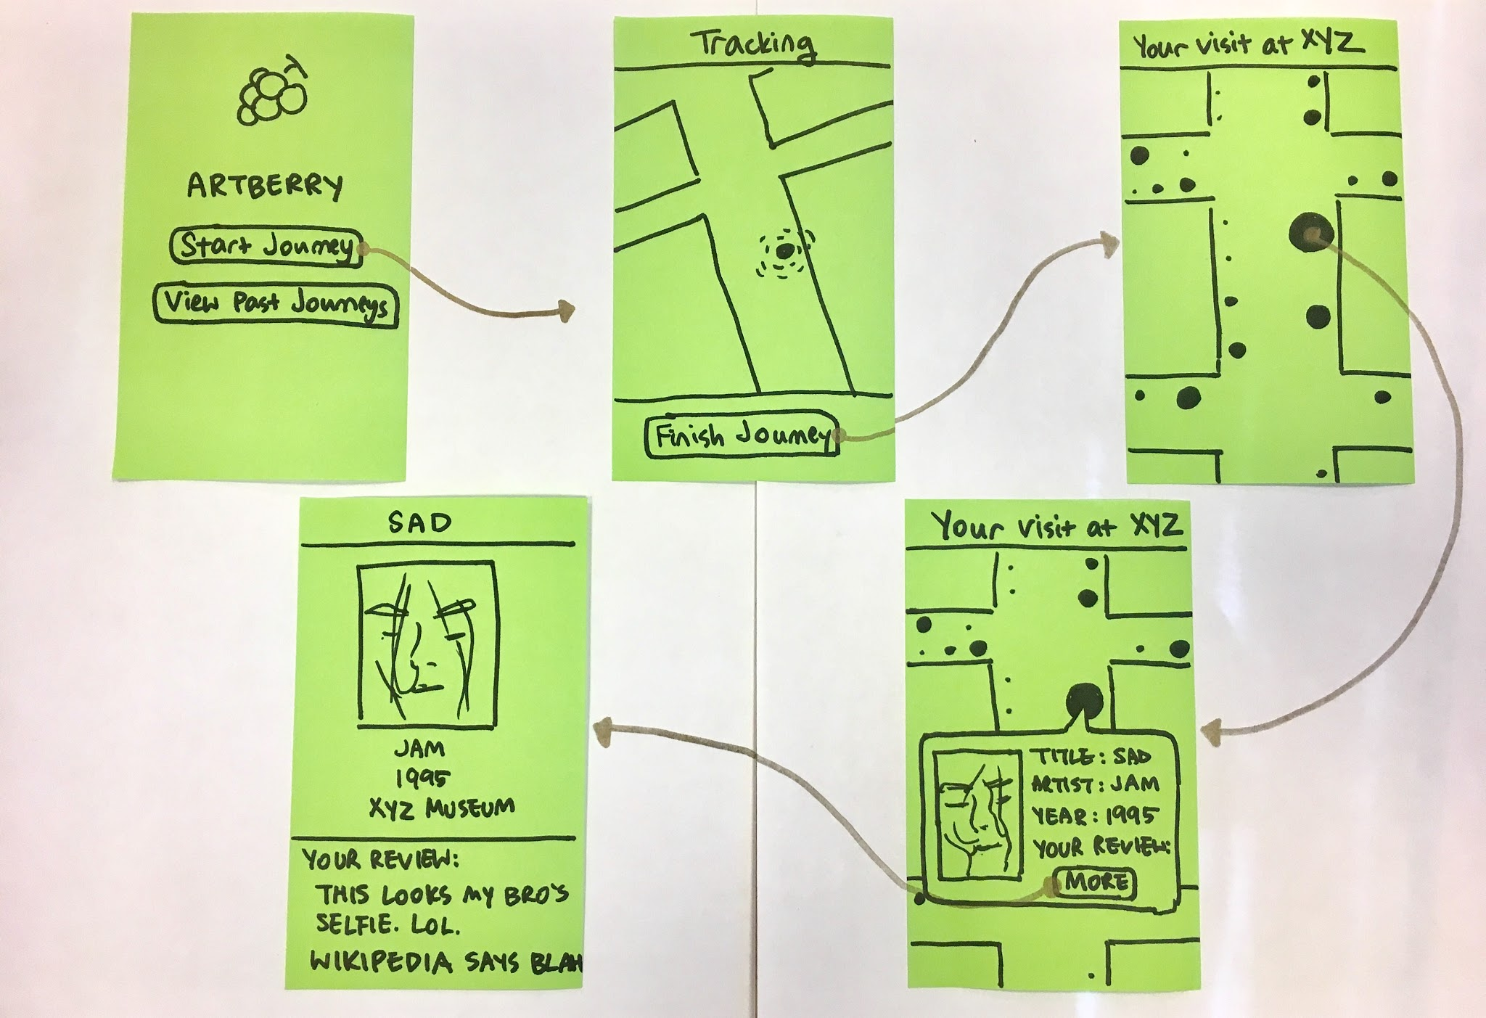
Concept Sketch #1: Automatic Tracking
Notes:
For our first design, we aimed to address the need to automatically track a user’s path and artworks viewed in a museum without any effort on the user’s end. The user will open the app and start their journey, and will not need to pull out their phone until the end to stop the journey. Using iBeacons or other smart IoT devices, the app will track time and the path the user took at the museum. The UI component of this design is the map that shows tracking as well as the museum visit overview at the end.
Beacons - IoT device that can send/receive info to/from any modern smartphones that are in x amount of meters from the beacon.

Slide 5
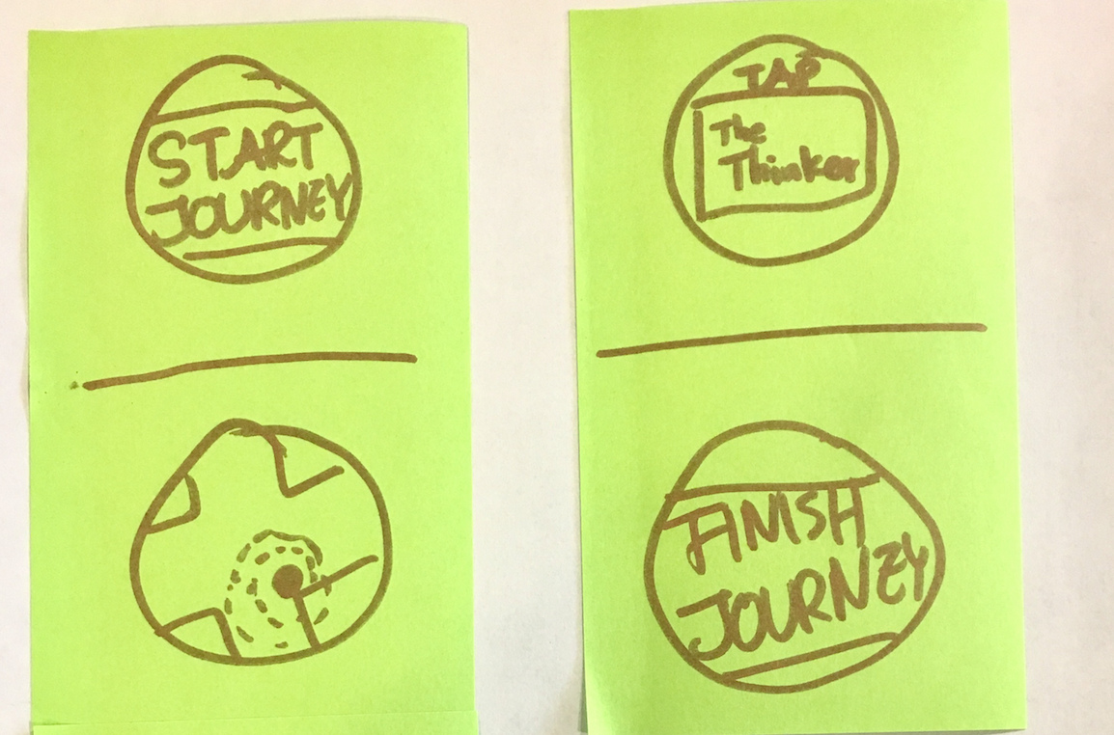
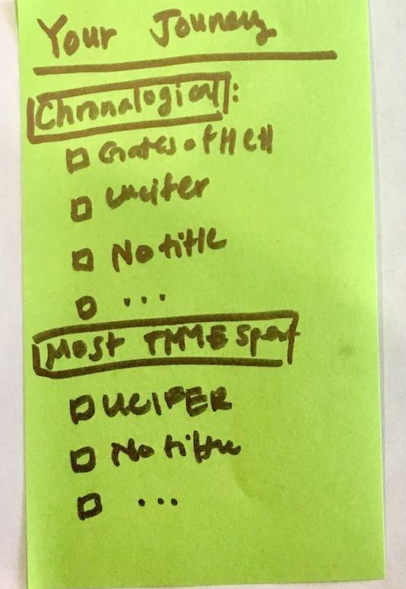
Sketch #2: Watch Tapping
Notes:
For our second design, we sought to keep with the theme of minimal effort on the user’s end to track their museum visit and decided on a smartwatch and mobile phone combination. The user will use the smartwatch to track their museum journey and “tap” in front of an art piece. The pieces that get tapped will be logged and displayed in the overall summary UI once the user finishes their visit.

Slide 6
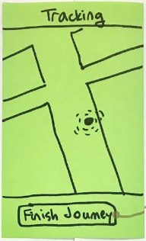
SELECTED INTERFACE & RATIONALE
Automatic Tracking
Effortless
Focus on the artwork without distraction
Contribution to the overall museum environment
Museums’ interest in using IoT devices
iBeacons
Notes:
We decided to pick the Automatic Tracking prototype because it aligns with a frequently cited need to track artwork without effort on the user’s end. It also lets the user focus on the artwork and contributes to the overall museum environment. The watch tapping prototype inherently presents an equipment barrier because smartwatches are not at the same level of ubiquity as smartphones. In addition, the Automatic Tracking prototype leverages iBeacons, a smart IoT device that is starting to see some use in businesses and shops. Museums may want to leverage these devices to gain more insight into visitor behavior, so our product would also align well with the museum’s interests.

Slide 7
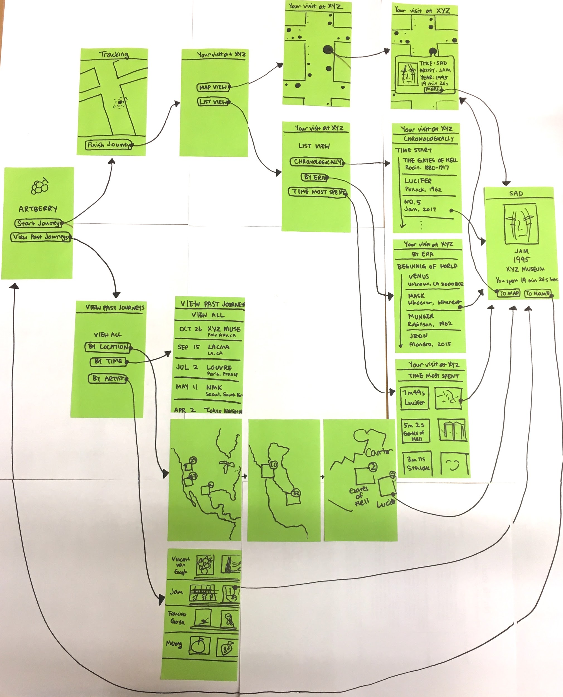
LOW-FI
PROTOTYPE

Slide 8
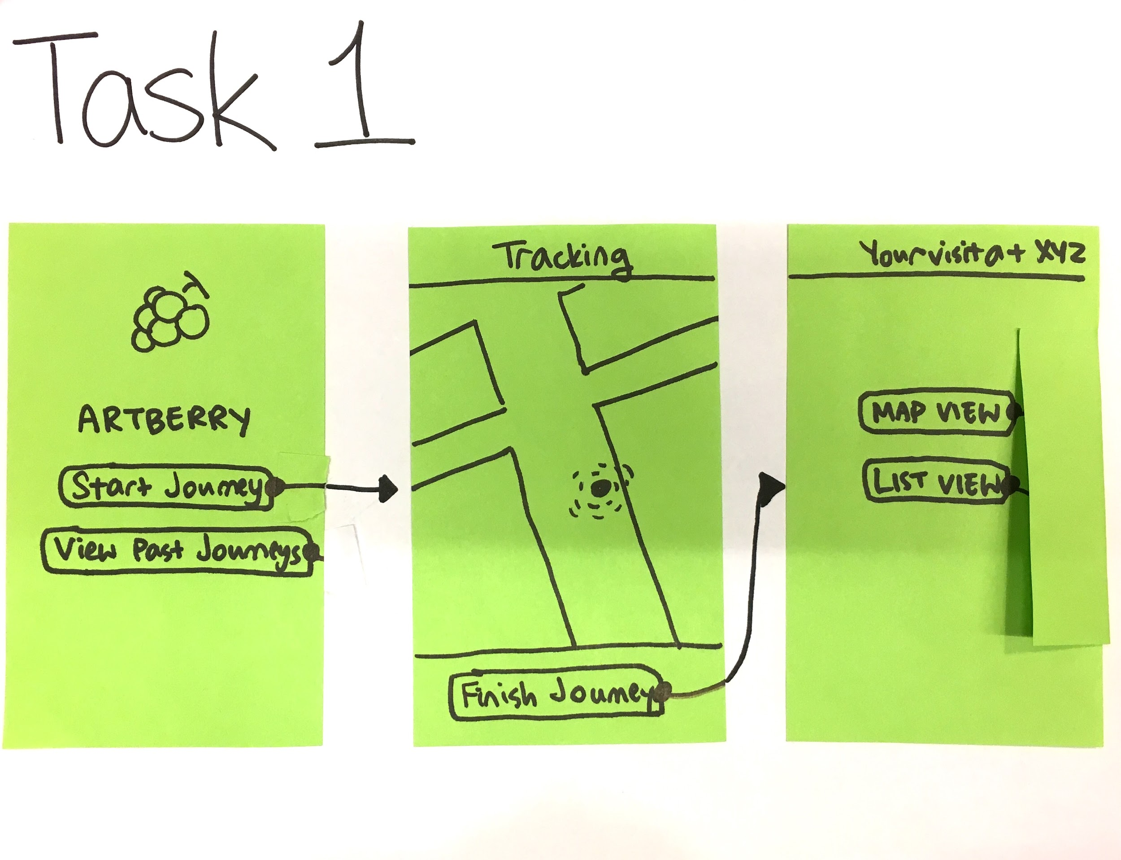
SIMPLE TASK
Notes:
Record pieces I find interesting at the museum
To accomplish this task, the user simply starts their journey from the home screen. From there, no further action is required during the museum visit. The app will run in the background and, through learning the user’s location from the iBeacons, will know which artworks are currently being viewed. At the end of the visit, the user can review their journey with the map UI that displays circles for the pieces viewed. The size of the circle corresponds to time spent at that piece which is correlated to the user’s interest in that piece.

Slide 9
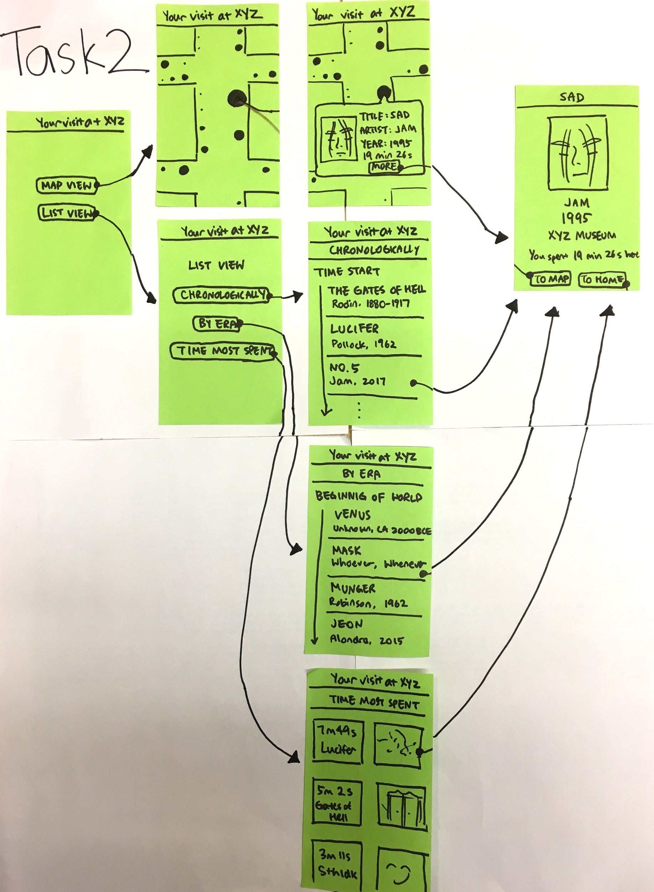
MODERATE
TASK
Notes:
Find the pieces I liked the most from the museum visit
The UI for a single museum visit can be reached one of two ways: 1) at the end of a museum visit through the ‘Finish Journey’ button, and 2) from the home page through the ‘View Past Journeys’ button. From here, a user can view a map of their visit with circles corresponding to time spent at each artwork (as discussed in the simple task description). However, the user can also view their artwork in a list format, sorted chronologically, by era, or by time most spent. The chronological sorting is to help the user remember the order and context in which they saw the pieces. The sorting by era is to help the user group the pieces by cultural significance. Sorting by time most spent allows the user to see which pieces they spent the most time at, with the goal of perhaps uncovering or helping the user remember pieces that they enjoyed but have forgotten after leaving the museum.

Slide 10
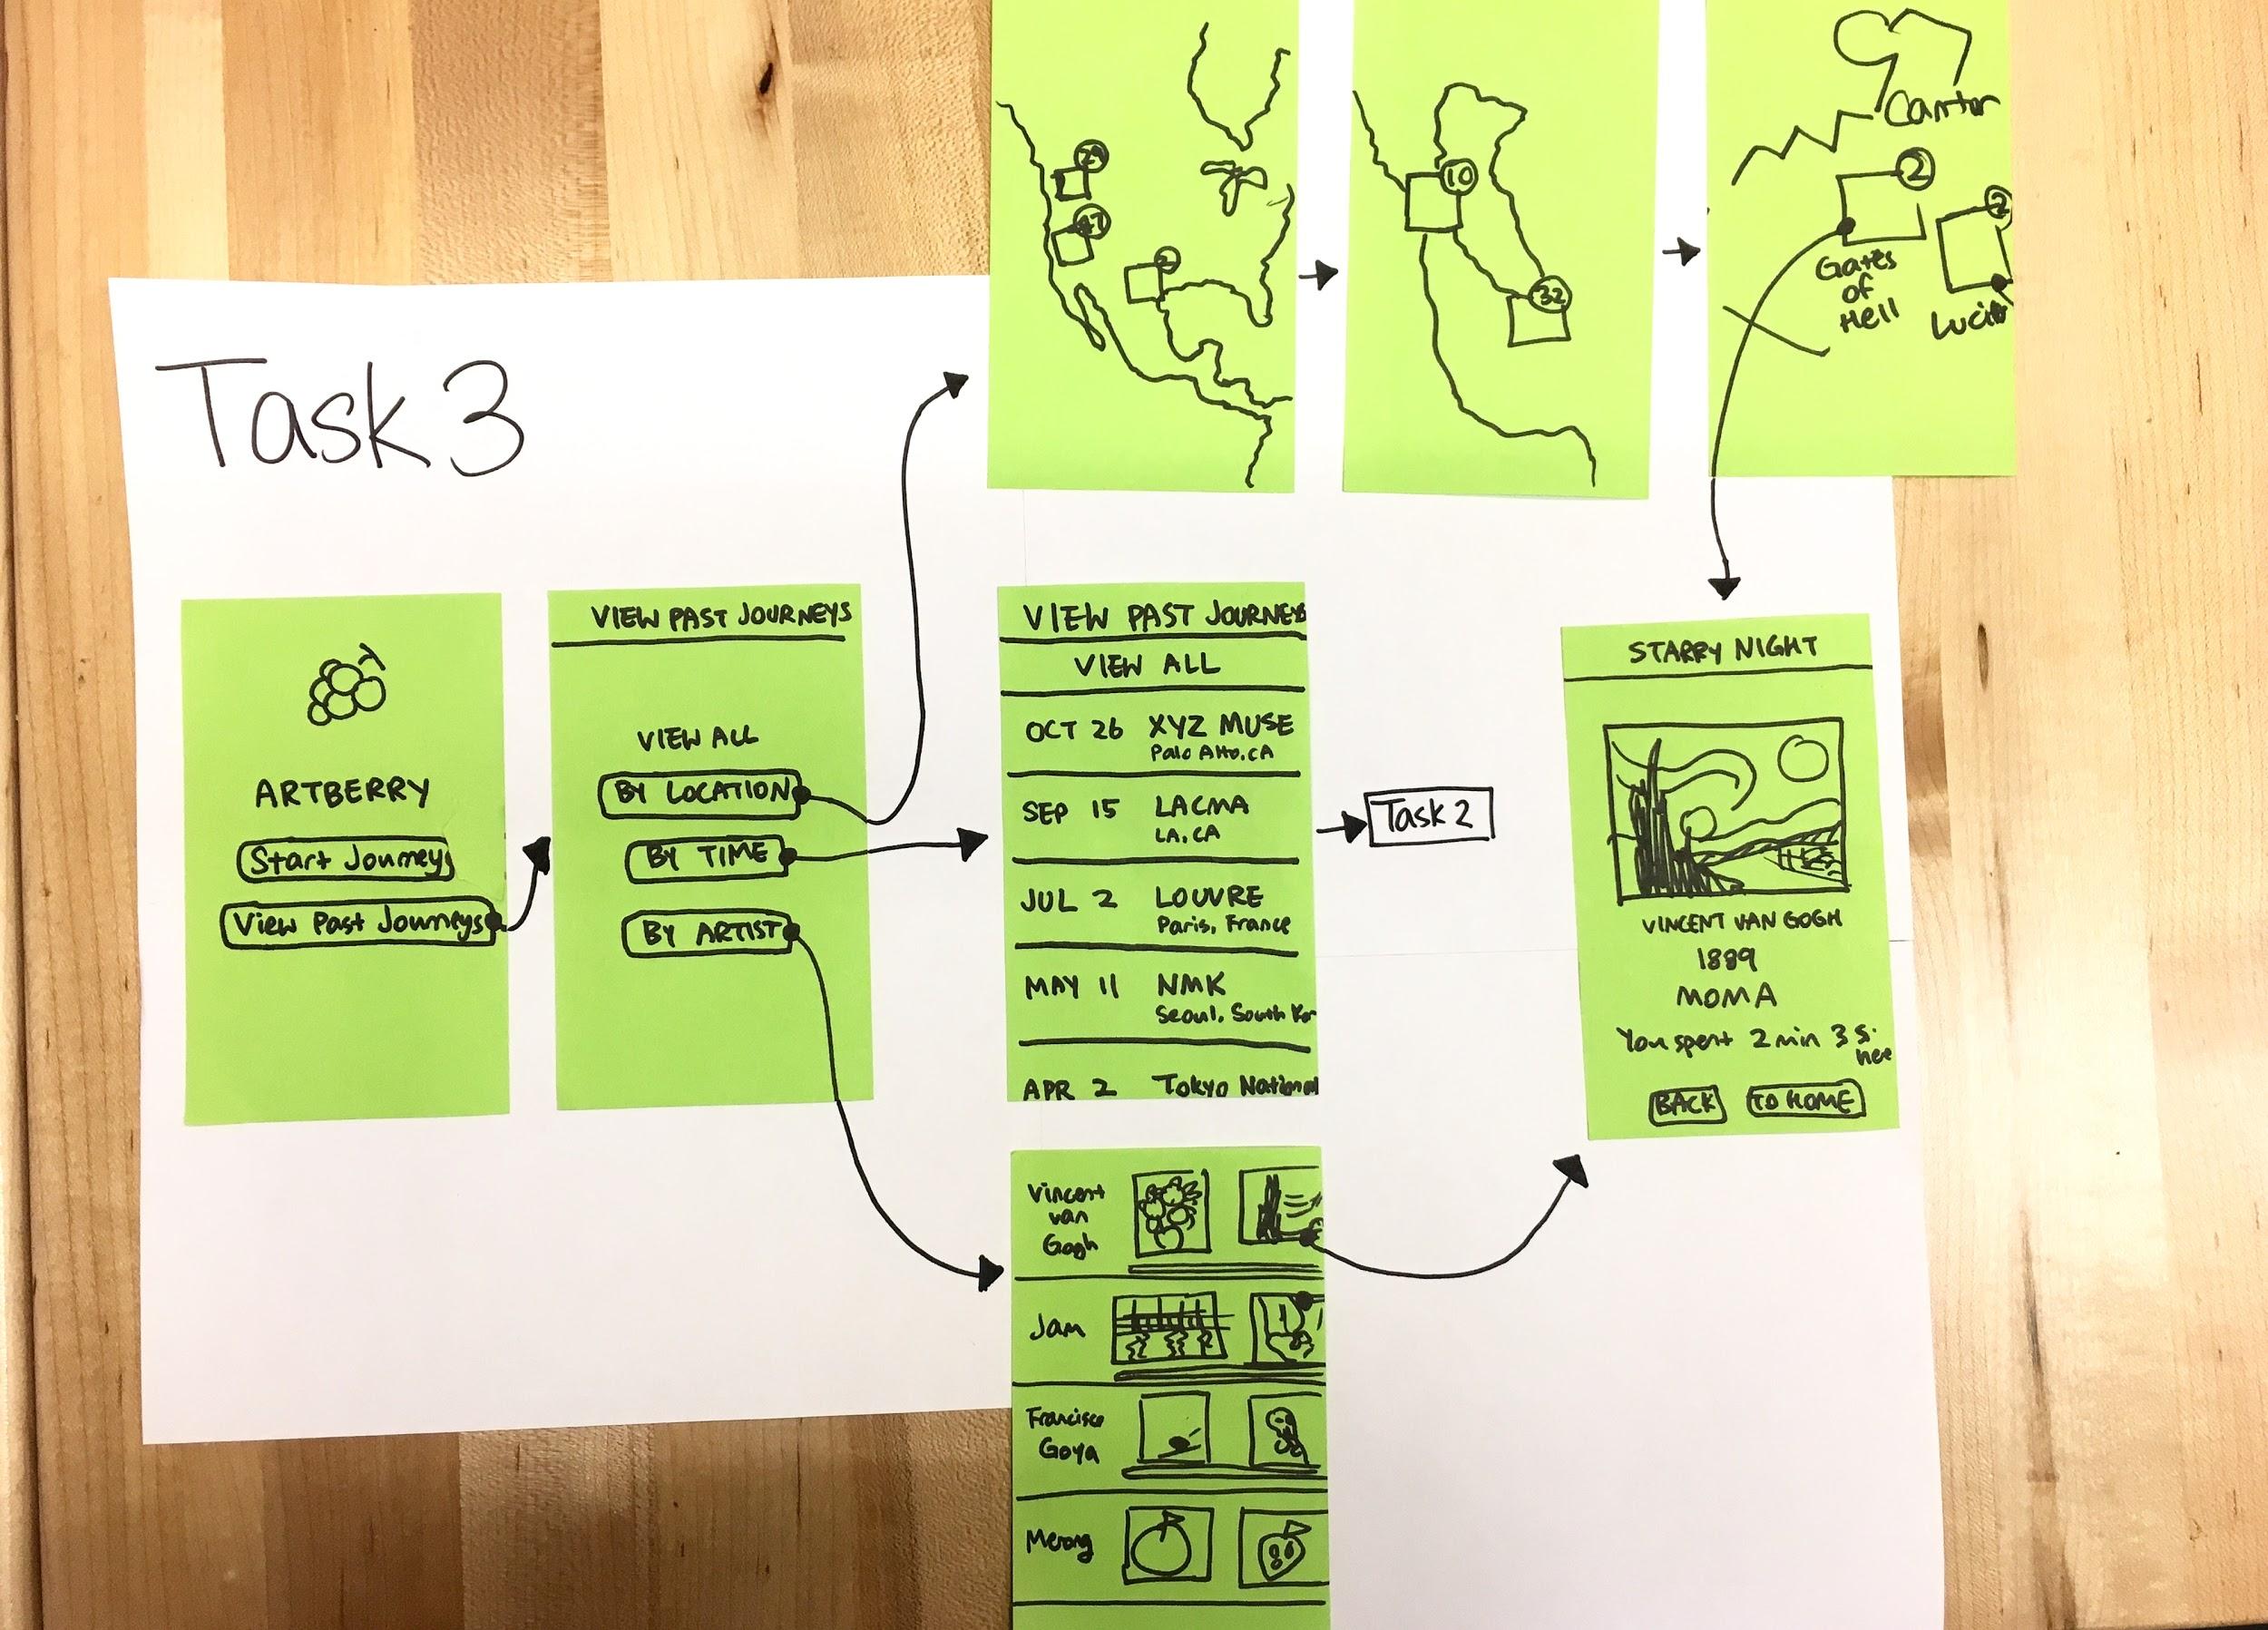
COMPLEX
TASK
Task flow
Notes:
Find connections between separate museum visits to learn more about my art taste
For looking across museum visits, this can also be accomplished through the ‘View Past Journeys’ button. The UI for this aggregates data across all the museums the user visited and tracked through Artberry. We chose to focus on presenting patterns by location for this assignment, but envision that this can easily be extended to other categories such as time and artist.
This feature is similar to Instagram’s geo-clustering of pictures through a map UI. We will have the world map with geotags that indicate the museums the user visited along with some highlights for the museums.

Slide 11
EXPERIMENTAL METHOD
Participant #1
Caucasian male
Late 20’s - 30’s
Background in art history
Participant #2
Caucasian female
early 20’s
Participant #3
Hispanic girl
Teenager
Tech-savvy
Location/Time: Thursday @ Cantor Arts Museum
Notes:
We chose to go on a Thursday because that is the day Cantor is open later and holds special events. As a result, we believed the visitors then are more likely to be interested in art, which better fits our target user demographic.
--
First, we introduced our names, our project, and handed them the consent form. When the consent was granted, we sat down, such that Junwon and Na He would be on either side of the user.
For each task, Junwon described a hypothetical situation to the user, and gave the user a task to perform, one at a time. Then as the user interacted with the prototype, Na He updated the screens by handing the user appropriate post-its. Junwon also encouraged the user to speak out the thought process they're going through, such as what they think different components (dots, lines, buttons) mean on the screen. Meanwhile, Irene and Raymond were sitting in the back, recording both the user's verbal and nonverbal feedback.

Slide 12
RESULTS
Participant #2
Understood the UI for all the tasks
Back button
Too many screens
Participant #3
“Self-explanatory” UI
Top left corner back button
Confused by the complex task
Participant #1
Verbalized understanding of the UI
Unsure of going back to home screen
Inconsistency in map view
Notes:
TEST MEASURES
Time it took the user to comprehend and move onto the next screen
Positive verbal affirmations
Assumptions, both correct and incorrect
Questions related to functionality
Number of pauses (getting stuck)

Slide 13
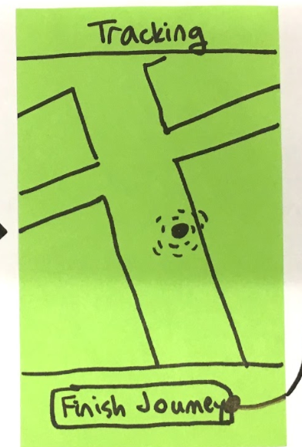
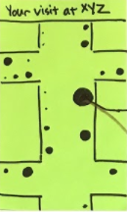
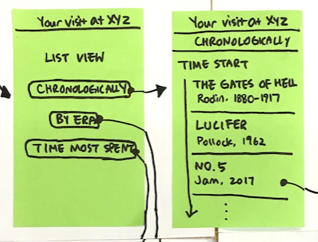
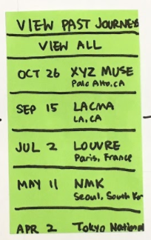
RESULTS
Orientation Inconsistency
No “Back” Button
Complex Task Confusion

Slide 14
SUGGESTED UI CHANGES
“It would be cool to have a button to send this to myself!”
Consistency in map view orientation
Back button
More distinction between UI to complete moderate vs. complex task

Slide 15
SUMMARY
Overall, our UI was intuitive and logical!
Main Issues:
Complex task UI
Unnecessary screens
Future Steps:
Better UI flow by task
Simpler, concise steps
Notes:
The biggest source of confusion during our tests was the complex task. As a result, we intend to remedy this by both fixing the home screen as well as fleshing out the specifics of the complex task. For the home screen, which currently just has two buttons (“Start Journey” and “View Past Journeys”), we will change this to be three buttons where each corresponds to a task (“Start Journey”, “View Past Journeys”, and “Discover Art Taste”). This will help users draw the distinction between the moderate task, which only looks at one museum visit, and the complex task, which aims to collect patterns and draw insights across all museum visits. This coming week, we aim to further explore what exactly our goal is with the complex task and make the screens more clear to reflect this.

Slide 16
THANK YOU!

